Slide 1

Priv-Guard: Creating a Personal VPN System
- Anirudh Kaplish, Archita Gupta, Aayush Tripathi

Slide 2

TARGET
Priv-Guard aims to empower users by providing a customizable and secure personal
VPN solution that protects their online privacy and data integrity.
Our target with Priv-Guard is to develop an intuitive, user-friendly VPN system that allows
individuals to effortlessly safeguard their internet activities and secure their digital footprint.
Priv-Guard is designed to meet the needs of users seeking a personalized VPN experience,
offering robust encryption and privacy features tailored to their specific requirements.
The goal of Priv-Guard is to deliver a highly secure and customizable VPN system that
enhances online anonymity and protects sensitive information from potential threats.
Priv-Guard targets users who value control over their online security, providing them with a
personal VPN solution that combines advanced protection with ease of use.

Slide 3

OBJECTIVE
To develop a user-friendly personal VPN system that provides strong encryption and
security for online activities.
To create a customizable VPN solution that allows users to tailor security features according
to their specific needs and preferences.
To implement advanced privacy protection measures in Priv-Guard, ensuring users' data and
online activities remain confidential and secure.
To ensure high performance and reliability of the VPN system, offering users a seamless and
uninterrupted browsing experience.
To design and deploy a straightforward setup and management process, making it accessible
for users with varying levels of technical expertise.

Slide 4
MATHEMATICS OF PROJECT
Cryptographic Algorithms:
Encryption and Decryption: Use of algorithms like AES (Advanced Encryption Standard) involves understanding the key length (e.g., 128-bit, 256-bit) and the mathematical operations for encryption and decryption.
Public Key Infrastructure (PKI): RSA (Rivest-Shamir-Adleman) algorithm involves key pair generation and the mathematical principles behind prime numbers and modular arithmetic.
2. Network Design:
IP Addressing and Subnetting: Calculations for subnet masks, IP address ranges, and network sizes to ensure efficient use of IP addresses.
Routing Protocols: Understanding algorithms like Dijkstra’s for shortest path calculations in routing.

Slide 5


3. Error Rates:
Error Detection and Correction: Mathematical methods for
detecting and correcting errors in data transmission, such as
Hamming codes or Reed-Solomon codes
4. Encapsulation Overhead:
Calculation of Overhead: Analyze the mathematical impact of
encapsulation methods used in tunneling protocols (e.g., IPsec, PPTP).
This involves understanding the size of various protocol headers and
metadata added to the original data packets, and how this affects the
overall data transmission efficiency. For instance, determining how
the addition of headers in IPsec (e.g., ESP or AH) influences packet size
and network performance.
5. Redundancy and Failover:
Redundancy Models: Mathematical models for designing fault-tolerant
systems, including the calculation of redundancy requirements and
failover strategies to maintain high availability.

Slide 6
Architecture
VPN Server:
Role: Manages connections, handles authentication, and performs encryption/decryption of data.
Components:
Authentication Module: Verifies user credentials and establishes secure connections.
Encryption Engine: Encrypts outbound data and decrypts inbound data.
Tunneling Module: Manages encapsulation and routing of data packets through the VPN tunnel.
Network Interface: Connects to the internet and the internal network.
VPN Client:
Role: Connects to the VPN server, initiates secure connections, and sends/receives encrypted data.
Components:
Authentication Module: Provides credentials and establishes a secure connection to the server.
Encryption Engine: Encrypts data before sending and decrypts received data.
Tunneling Module: Handles encapsulation and routing of data through the VPN tunnel.
Network Interface: Connects to the local network and the VPN server.
Data Flow:
Client to Server: Data is encrypted and encapsulated before transmission through the VPN tunnel.
Server to Client: Data is decrypted and decapsulated upon receipt.

Slide 7
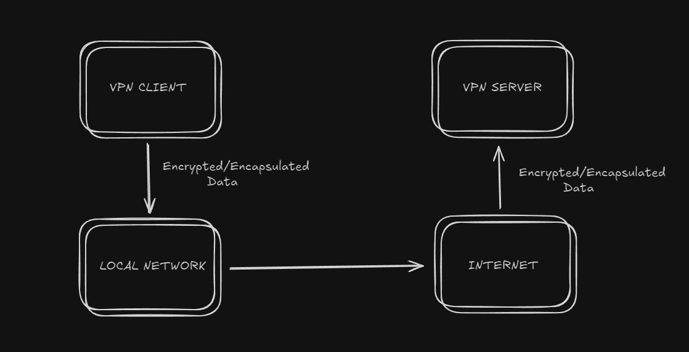
BLOCK DIAGRAM

Slide 8

TOOLS
Tools
Development Tools:
Programming Languages: C
IDE: Visual Studio
Networking Tools:
Wireshark: For packet analysis and debugging.
OpenVPN: For testing and prototyping VPN implementations.
GNS3: For network simulation and design.
Encryption Libraries:
OpenSSL: For implementing encryption algorithms and secure communication.
Simulation Tools:
Cisco Packet Tracer: For visualizing and simulating network topologies.

